Slide 1

Title : Exploring Green Destinations
through Data Analytics
Subtitle : Harnessing Data for
Sustainable Travel

Slide 2

Introduction to Green Destinations
What are Green Destinations?
Content:
Definition: Green destinations are locations committed to sustainable tourism practices.
Importance: They prioritize environmental conservation, cultural preservation, and community well-being.
Examples: Costa Rica, Iceland, New Zealand.

Slide 3



Slide 4
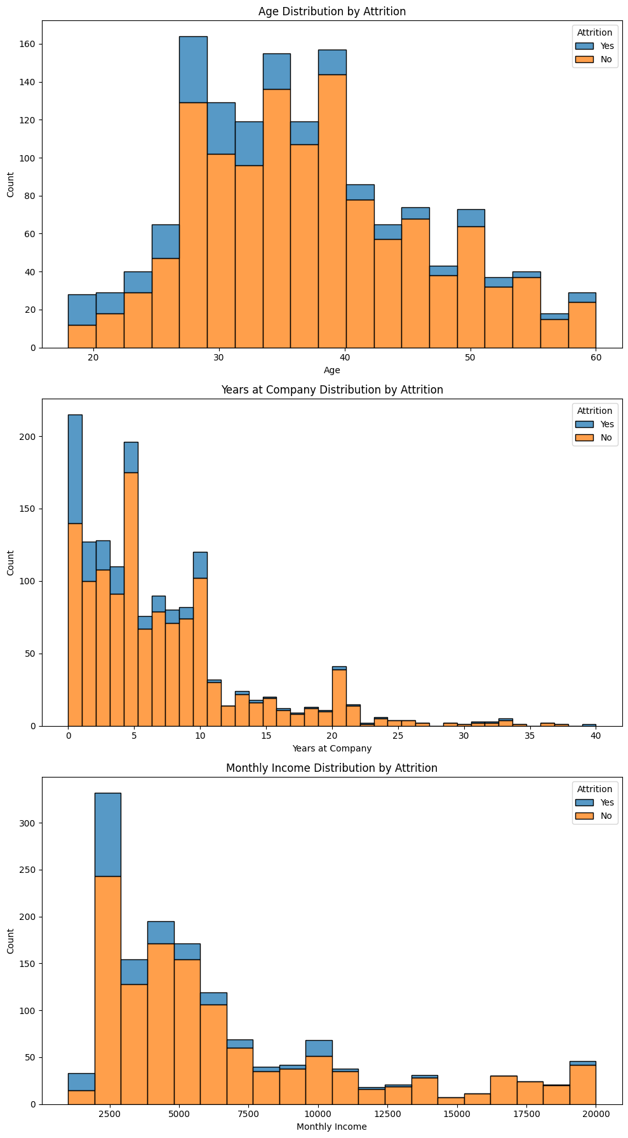
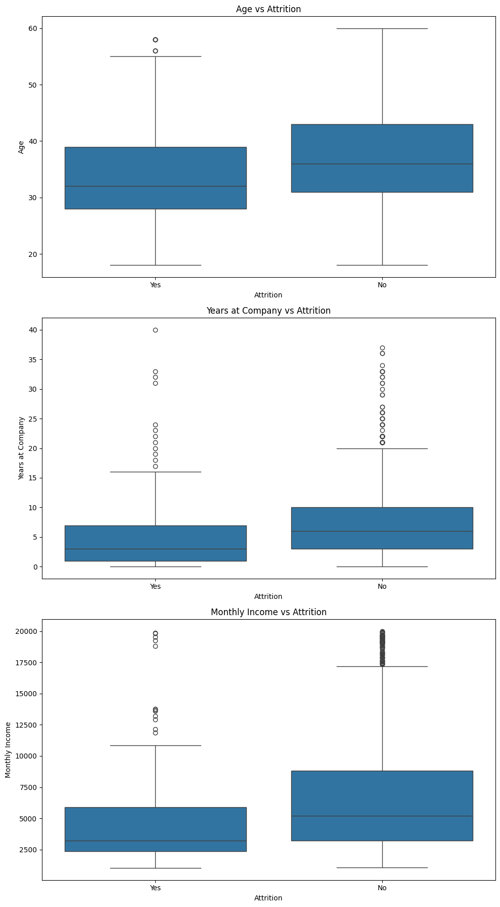
Static graphs

Slide 5
MOCK DASHBOARD

Slide 6
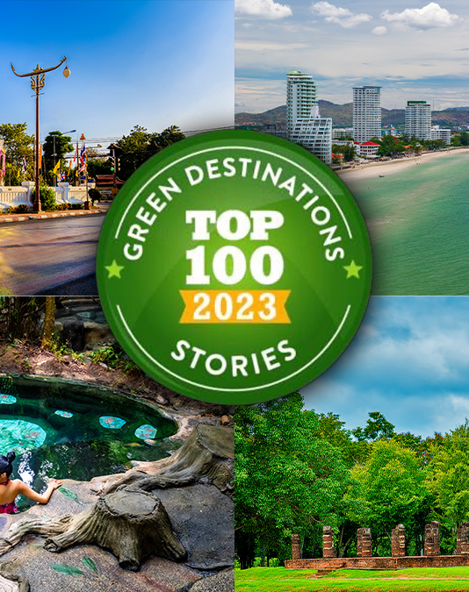
Future Work : Enhance data integration
from diverse sources.
Develop predictive models for better
resource management.
Promote collaborations between data
scientists and environmentalists.
Call to Action : Embrace data-driven
approaches to support sustainable
travel and protect our planet.

Slide 7


